Slide 1
What should be the future direction of United States trade policy?
Alan V. Deardorff
For presentation to
Washtenaw County Democratic Party
September 6, 2017

Slide 2
Outline
US Trade Policy Past
  Policy
  Performance
US Trade Policy Future
  Without Trump
  With Trump
    Addressing the trade deficit
    Renegotiating NAFTA
    Other

Slide 3

US Trade Policy Past
US Leadership since World War II
  Rounds of multilateral tariff reductions
  Discipline on nontariff barriers
  Expanded coverage to
    Services
    Intellectual Property
  All done through GATT, then WTO

Slide 4
US Trade Policy Past
International Rule of Law
  GATT/WTO agreed rules for uses of trade policies
    Enforced through sanctioned retaliation
  Rules permitted “trade remedies,” but constrained their use
    Safeguards tariffs
    Anti-dumping duties
    Countervailing duties (against subsidies)

Slide 5
US Trade Policy Past
Regional trade agreements
  EU was pioneer with customs union
    6-country EEC grew to 28-country EU (soon 27)
  US resisted, but then negotiated
    US-Canada FTA 1989
    NAFTA 1994
  Many others followed, mostly with FTAs

Slide 6
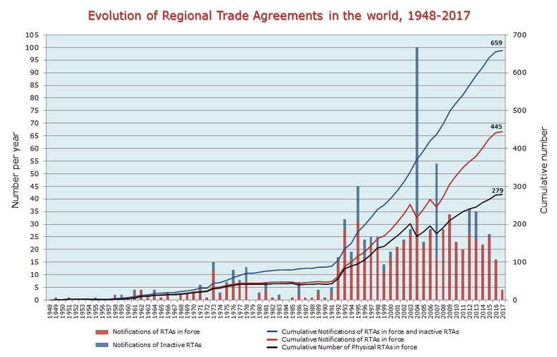
FTAs

Slide 7
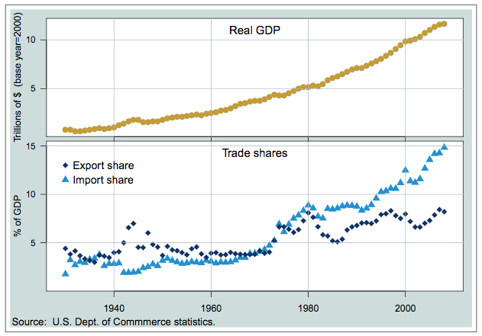
US GDP & Trade
Notes:
From USITC, US Trade Policy since 1934,

Slide 8
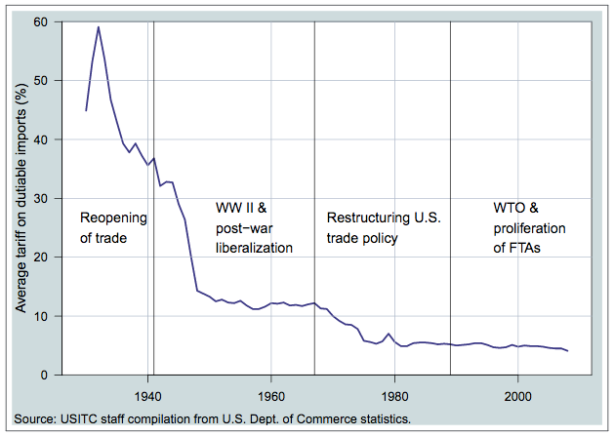
US Tariffs
Notes:
From USITC, US Trade Policy since 1934,

Slide 9
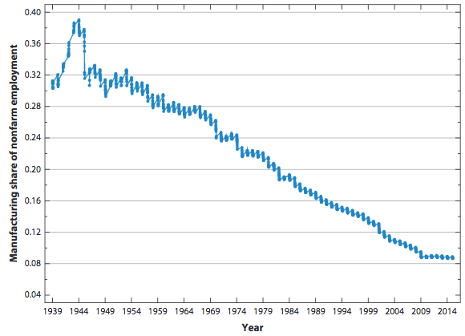
US Manufacturing Employment
Notes:
From Autor, Dorn, Hanson, Annual Review of Economics, 2016

Slide 10
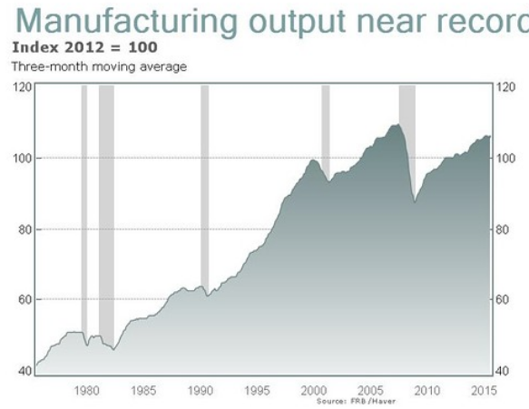
US Manufacturing Output
Notes:
http://www.marketwatch.com/story/us-manufacturing-dead-output-has-doubled-in-three-decades-2016-03-28

Slide 11
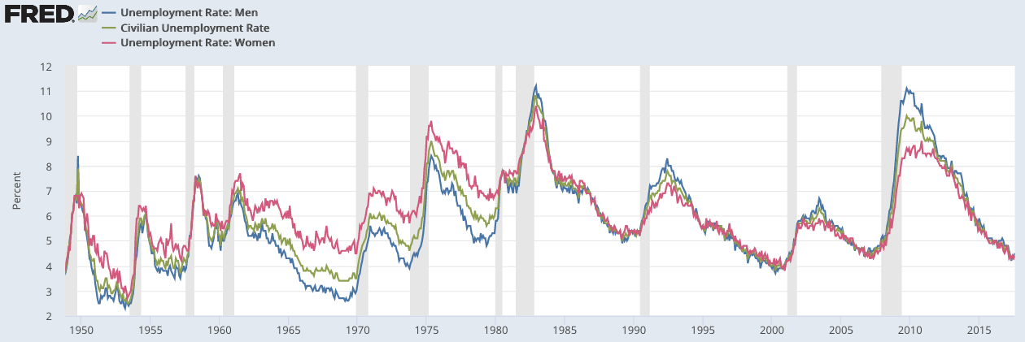
US Unemployment
Notes:
https://fred.stlouisfed.org/graph/?g=8ej8&&utm_source=fred.stlouisfed.org&utm_medium=Referral&utm_term=related_resources&utm_content=&utm_campaign=graph

Slide 12
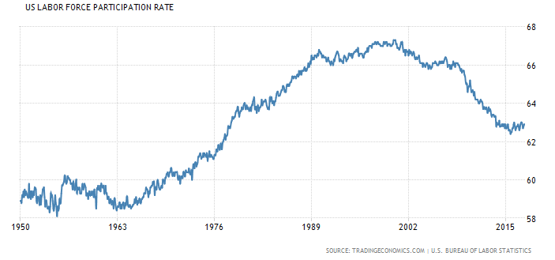
US Labor Force Participation
Notes:
https://tradingeconomics.com/united-states/labor-force-participation-rate

Slide 13
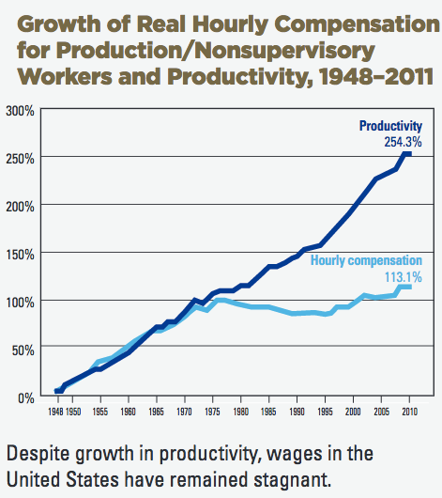
Notes:
AFL-CIO, "NAFTA at 20," March 2014.

Slide 14
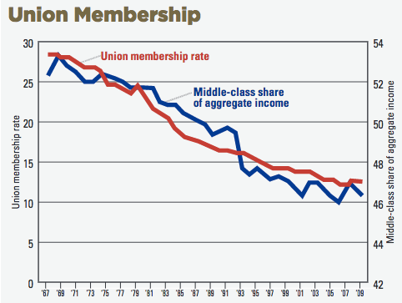
US Unions
Notes:
AFL-CIO, "NAFTA at 20," March 2014.

Slide 15
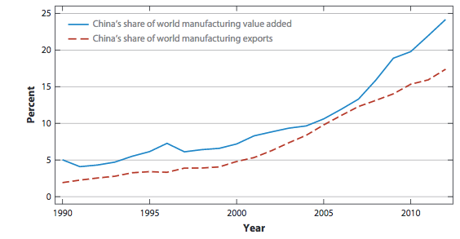
China manufacturing
Notes:
From Autor, Dorn, Hanson, Annual Review of Economics, 2016

Slide 16
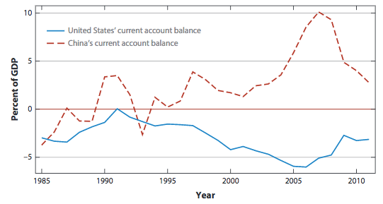
US and China
Current Account Balances
Notes:
From Autor, Dorn, Hanson, Annual Review of Economics, 2016

Slide 17
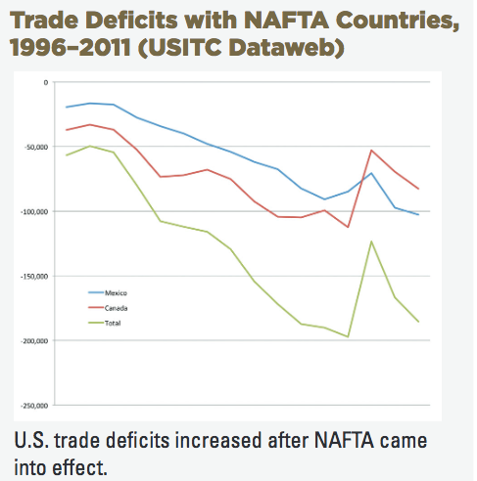
Notes:
AFL-CIO, "NAFTA at 20," March 2014.

Slide 18
US Trade Policy Future:
Without Trump
More multilateral liberalization?
  No.
  Attempt of Doha Round failed

Slide 19
US Trade Policy Future:
Without Trump
More regional agreements?
  Yes
  Trans-Pacific Partnership (12 countries)
  Trans-Atlantic Trade and Investment Partnership (US and EU)

Slide 20
US Trade Policy Future:
Without Trump
Continued support for World Trade Organization
  US would take its disputes to the WTO
  US would work with other WTO members to advance the cause of trade with smaller agreements

Slide 21
US Trade Policy Future:
Without Trump
Continued use of WTO-permitted trade remedies (“trade law enforcement”)
  Safeguards tariffs
    Against imports causing injury
  Anti-dumping duties
    Against imports “unfairly priced”
  Countervailing duties
    Against subsidized imports

Slide 22
Trump Trade Policy:
Trade Deficits
First priority: Reduce US trade deficits
  Overall trade deficit with the world
  Bilateral trade deficits with China, Mexico, Canada, etc.
  Trump blames trade agreements (NAFTA, WTO) for being unfair to US and causing these deficits
  Says that deficits, in turn, cost US jobs

Slide 23
Trump Trade Policy:
Trade Deficits
Can he reduce US trade deficits?
  No! Not with tariffs or trade restrictions.
  Overall trade deficit equals
    Imports minus exports
    What we buy minus what we produce
    Spending minus income
  No trade agreement (or trade policy) will change the fact that the US spends more than its income

Slide 24
Trump Trade Policy:
Trade Deficits
Bilateral trade deficits with individual countries?
  Yes, perhaps.
  The sum of all bilateral deficits must equal the total, and that won’t change, unless it reduces US spending
  But policies can re-direct our imports from one country to another
  Example, if we cut our imports from Mexico, we’ll buy that much more from someone else (China?)

Slide 25
Trump Trade Policy:
NAFTA
Trump called NAFTA: “The single worst trade deal ever approved in this country”
  Was it?

Slide 26
NAFTA – What Happened
Peso Dropped One Year After
NAFTA
Mexico Exchange Rate
Peso Crisis
Quarterly 1988-2004
0.5
0.4
$/peso
0.3
0.2
0.1
0
Q1 1988
Q2 1989
Q3 1990
Q4 1991
Q1 1993
Q2 1994
Q3 1995
Q4 1996
Q1 1998
Q2 1999
Q3 2000
Q4 2001
Q1 2003
Q2 2004
Notes:
Source of data in slide and following: IMF IFS online

Slide 27
NAFTA: What Happened - Mexico Reserves Dropped at Once
NAFTA
Peso Crisis

Slide 28
NAFTA: What Happened - Mexico
GDP Fell after Peso Crisis
NAFTA
Mexico Real GDP
Peso Crisis
1993=100
160
140
120
100
80
60
40
20
0
Q1 1988
Q2 1989
Q3 1990
Q4 1991
Q1 1993
Q2 1994
Q3 1995
Q4 1996
Q1 1998
Q2 1999
Q3 2000
Q4 2001
Q1 2003
Q2 2004

Slide 29
NAFTA: What Happened - Mexico
Imports Fell after Crisis
NAFTA
Peso Crisis

Slide 30
NAFTA: What Happened - Mexico
Wages Fell after Crisis
NAFTA
Peso Crisis

Slide 31
NAFTA: What Happened - Mexico Real Wages Plummeted!
NAFTA
Peso Crisis

Slide 32
NAFTA: What Happened - US Unemployment: No effect (or fell)
NAFTA
Peso Crisis

Slide 33
NAFTA: What Happened - US Trade: Continued growth
NAFTA
Peso Crisis

Slide 34
NAFTA: What Happened - US
Real Wage: No Change
NAFTA
Peso Crisis

Slide 35
NAFTA: What Happened
Trade Grew, More To US than From
NAFTA
Peso Crisis

Slide 36
Trump Trade Policy:
NAFTA
Threatened first to pull out of NAFTA
Was persuaded to “renegotiate” instead
  By leaders of Canada and Mexico
  By US business interests
Why? Because NAFTA permitted supply chains to extend across borders.
Trump seeks to use the threat to get a “better deal”

Slide 37
Trump Trade Policy:
NAFTA
What will the better deal be?
  Tighter “rules of origin”
  Improved access to Canada for US dairy
  Revise Investor-State Dispute Settlement
  Drop Chapter 19, that arbitrates AD & CVD
  Include “Buy American” for governments
  Prevent currency manipulation

Slide 38
Trump Trade Policy:
Other Issues
Several that have come and gone
  Huge tariff on China
    Mentioned during campaign, but not since
  Border adjustment tax
    Resisted by US retailers
  Tariffs on imports of steel and aluminum
    Resisted by manufacturers that need these inputs

Slide 39
Trump Trade Policy:
Other Issues
Korea-US FTA: Pull out of that too, or renegotiate? (Said yes, Sep 2; said no Sep 5)
Case against China for violating US intellectual property rights
  Filed under Section 301 of US trade law
  Hasn’t been used for years, and likely illegal under WTO
Actions on currency manipulation?

Slide 40
Conclusions?
It’s very hard to know what US trade policy will be under Trump
  At his most extreme, he threatens
    Greatly increased protectionism
    Trade war
    Extreme economic harm to US
  His actions so far have mostly been far more mild and conventional

